Slide 1
Spatiotemporal Reconstruction, Navigation, and Relational Memory in the Hippocampus
Introduction
Reconstructing Relational Information
Spatiotemporal Reconstruction
Spatiotemporal Navigation
Conclusion
Kevin Horecka, December 1st, 2017 Preliminary Examination

Slide 2
Outline
Introduction
Reconstructing Relational Information
Spatiotemporal Reconstruction
Spatiotemporal Navigation
Conclusion
General Introduction
Reconstructing Relational Information
Spatiotemporal Reconstruction
Spatiotemporal Navigation
General Conclusions

Slide 3

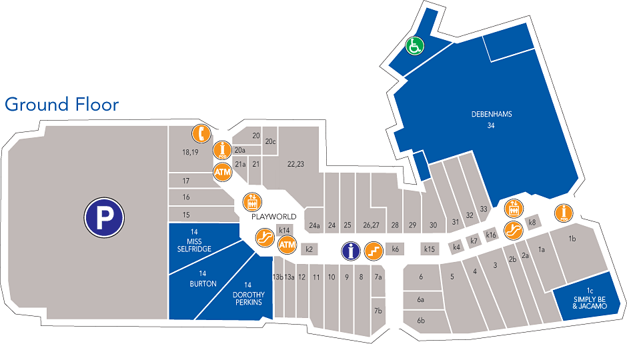
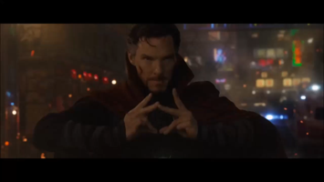
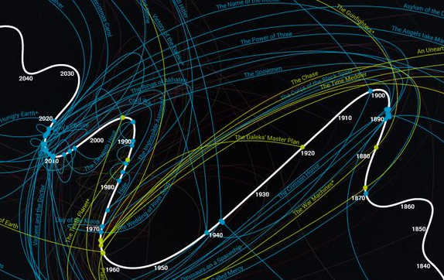


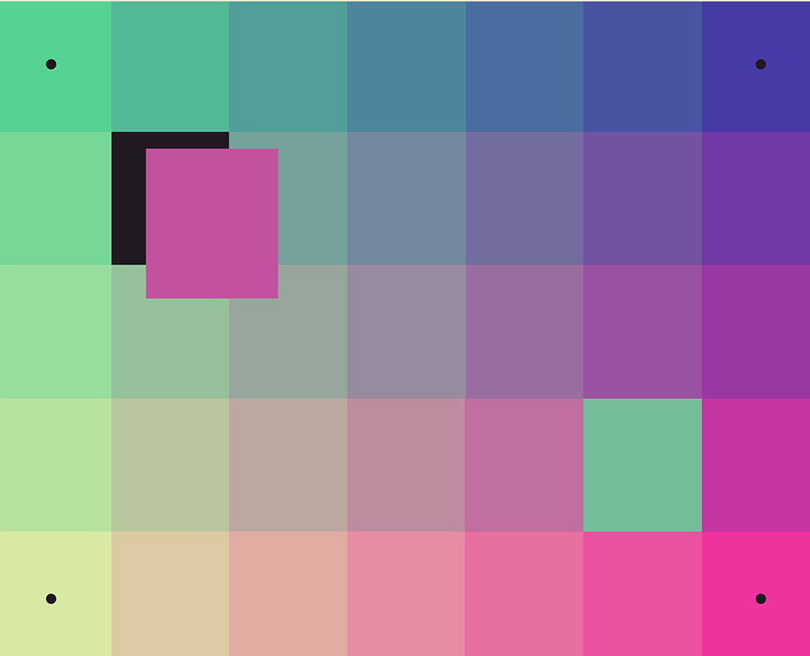
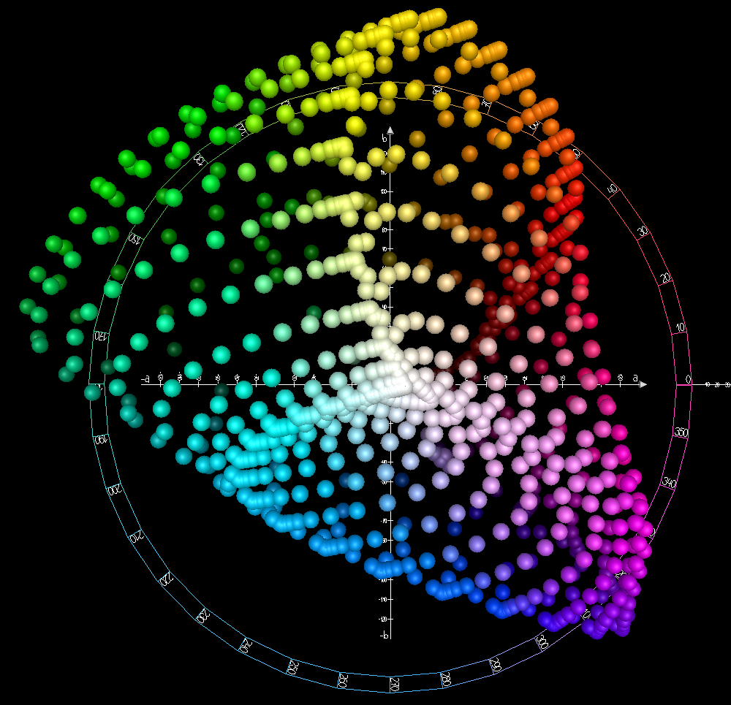
What is reconstruction?
Introduction
Reconstructing Relational Information
Spatiotemporal Reconstruction
Spatiotemporal Navigation
Conclusion
Begin with some data in a (usually continuous) domain
Space
Time
Color
Social Space

Slide 4
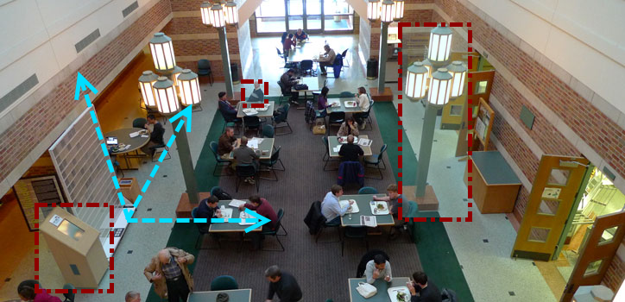
Real-World Reconstruction
Introduction
Reconstructing Relational Information
Spatiotemporal Reconstruction
Spatiotemporal Navigation
Conclusion

Slide 5
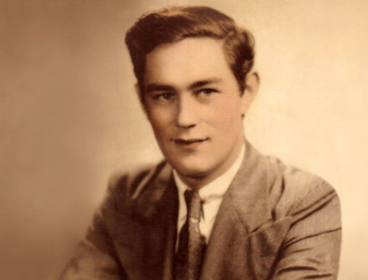
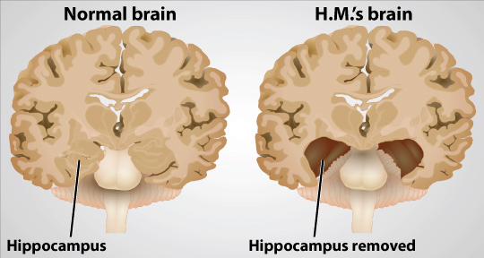
Episodic Memory
Introduction
Reconstructing Relational Information
Spatiotemporal Reconstruction
Spatiotemporal Navigation
Conclusion
Episodic memory can be defined as memory for specific/precise events in space and time, framed by context
Episodic memory is destroyed by bilateral removal of hippocampal structures (see Patient H.M., right)
In the introduction of Episodic Memory in Tulving, 2002, Episodic Memory is described as “a singular exception” to the “unidirectionality of time”

Slide 6
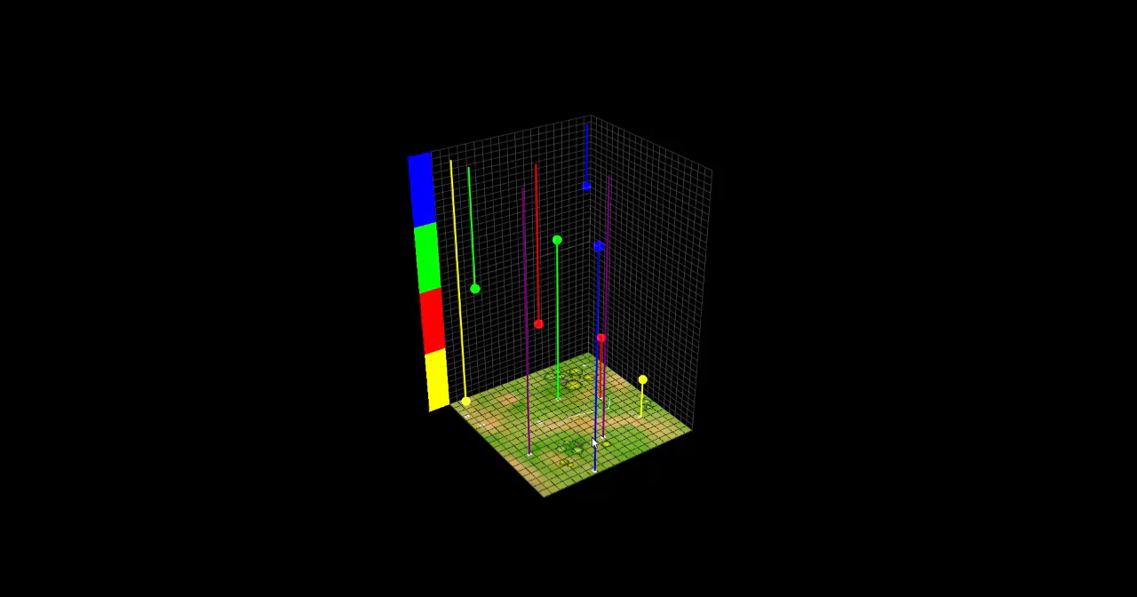
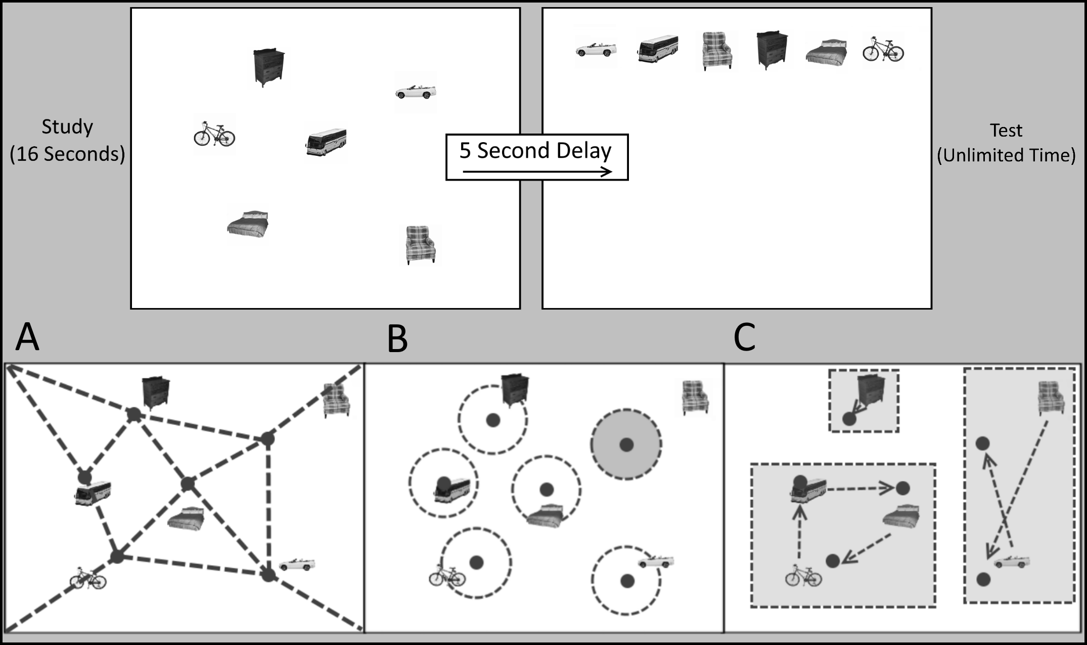
Reconstruction Tasks
Introduction
Reconstructing Relational Information
Spatiotemporal Reconstruction
Spatiotemporal Navigation
Conclusion
Reconstruction Tasks ask participants to:
Study some information in a domain
Place that information back in the domain the way they remember it being

Slide 7
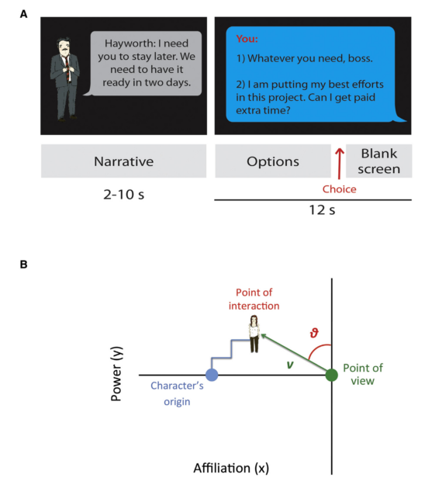
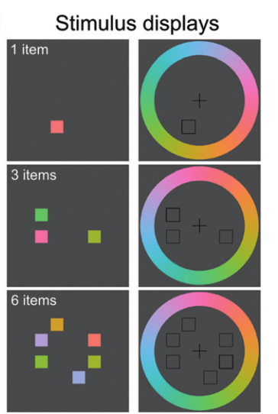
Alternative Reconstruction Domains
Introduction
Reconstructing Relational Information
Spatiotemporal Reconstruction
Spatiotemporal Navigation
Conclusion
Social “Space”
Tavares et al. 2015
Color “Space”
Warren et al. 2015

Slide 8
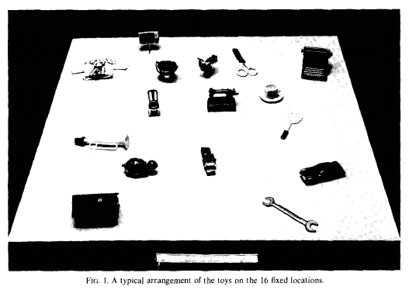
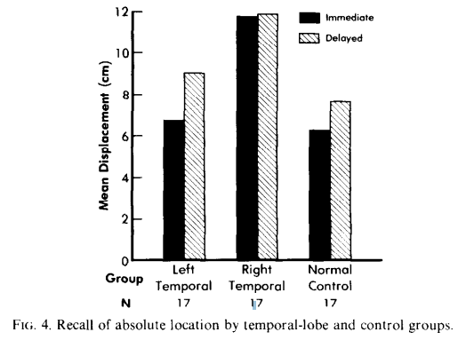
Smith and Milner 1981
Introduction
Reconstructing Relational Information
Spatiotemporal Reconstruction
Spatiotemporal Navigation
Conclusion
Reconstruction in hippocampal damaged patients
Right temporal lobe patients showed a deficit in location memory immediately
Both temporal lobe damage patient groups showed location memory impairment after delays

Slide 9
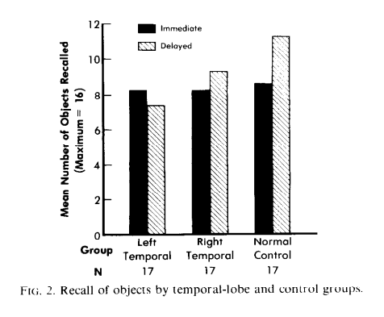
Smith and Milner 1981 Item Memory
Introduction
Reconstructing Relational Information
Spatiotemporal Reconstruction
Spatiotemporal Navigation
Conclusion
No group differences in item memory with immediate test
Both temporal lobe damage patient groups showed item memory impairment after delays
Left temporal lobe patients were numerically worse than right temporal lobe patients

Slide 10
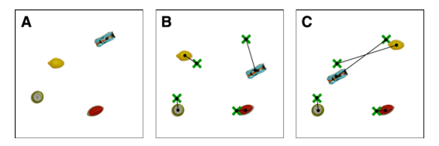
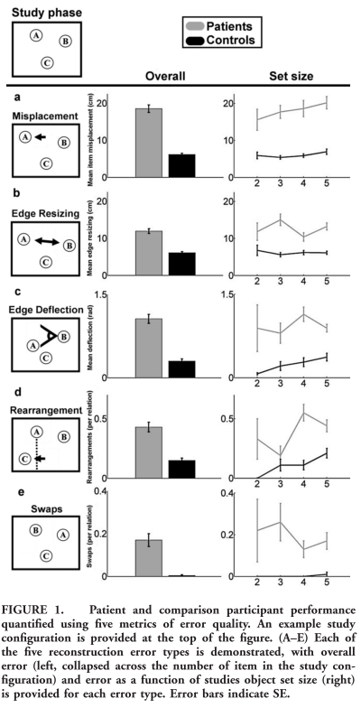

Jeneson et al. 2010 & Watson et al. 2013
Introduction
Reconstructing Relational Information
Spatiotemporal Reconstruction
Spatiotemporal Navigation
Conclusion
Similar to Smith & Milner with fewer items
Varied number of items (up to 7 and 5, respectively)
Analysis was very coarse (lacking specificity and sensitivity)
Both showed deficits in misplacement and relational errors (interchanging or “swapping” of pairs of items)

Slide 11
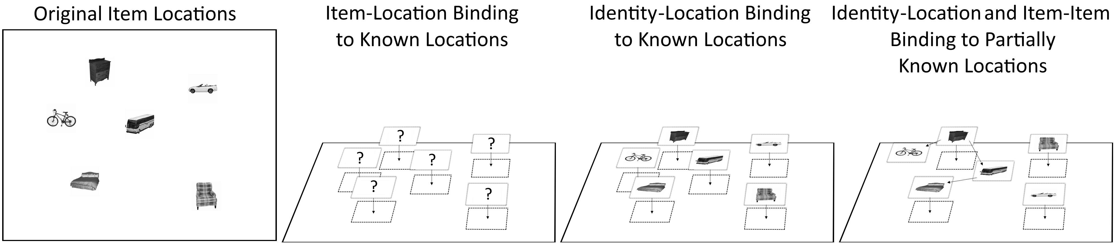
Models of Information in Reconstruction
Introduction
Reconstructing Relational Information
Spatiotemporal Reconstruction
Spatiotemporal Navigation
Conclusion
After reconstruction, some level of inference is required to determine what information was/wasn’t present in the reconstructed locations
The framework involves three key types of information
Identity-location binding
Location-location (or Item-item) relations
Location-environment (or Item-environment) relations
Misplacement error can be broken down into these different types of information

Slide 12




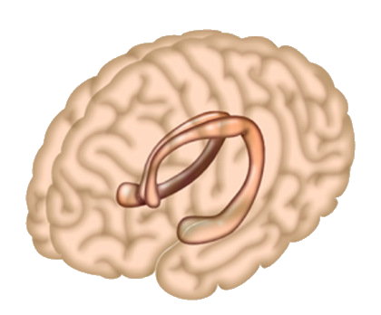






Bringing it All Together
Introduction
Reconstructing Relational Information
Spatiotemporal Reconstruction
Spatiotemporal Navigation
Conclusion
Context
Episodes
Space
Time
Sampling

Slide 13
Reconstructing Relational Information
Introduction
Reconstructing Relational Information
Spatiotemporal Reconstruction
Spatiotemporal Navigation
Conclusion
Study 1 (In Press)
Episodes
Space

Slide 14
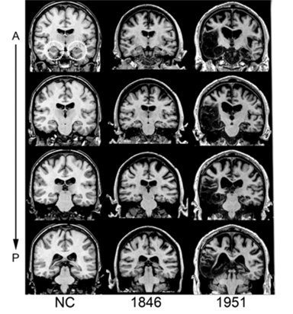
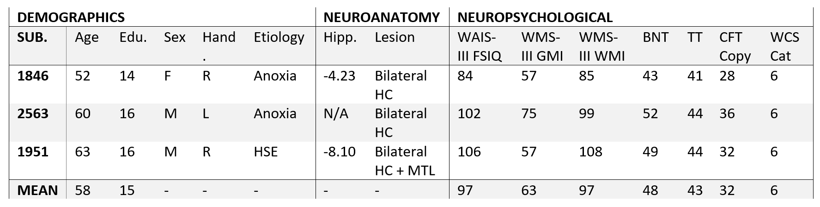
Patient Demographics
Introduction
Reconstructing Relational Information
Spatiotemporal Reconstruction
Spatiotemporal Navigation
Conclusion
3 patients with bilateral HC damage (one, 1951, with additional MTL damage)
9 age and education matched controls
Patients had normal performance on measures of intelligence, language, visual perception, and executive function

Slide 15





Spatial Reconstruction The iPosition Task
Introduction
Reconstructing Relational Information
Spatiotemporal Reconstruction
Spatiotemporal Navigation
Conclusion

Slide 16
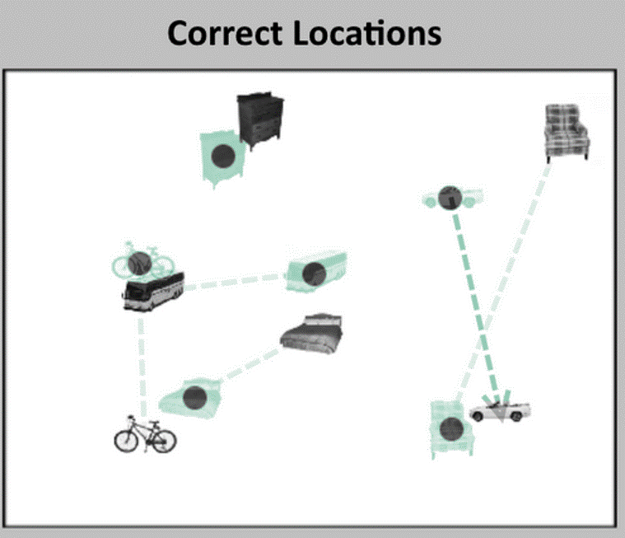
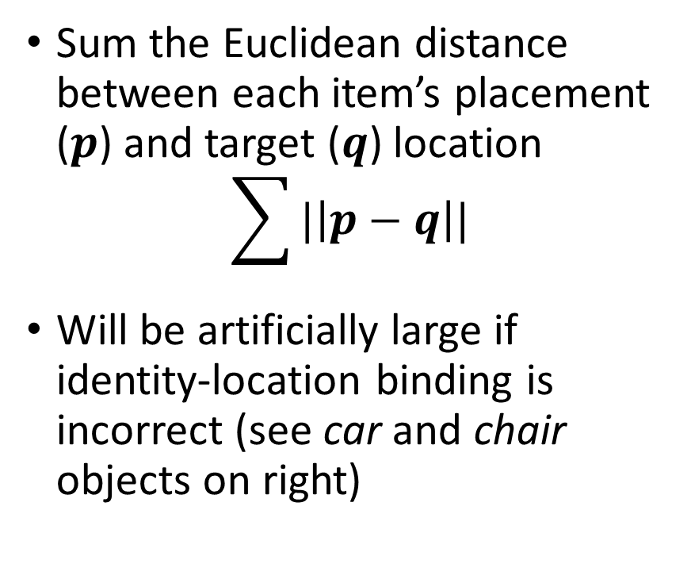
Traditional Analysis Misplacement
Introduction
Reconstructing Relational Information
Spatiotemporal Reconstruction
Spatiotemporal Navigation
Conclusion
Sum the Euclidean distance between each item’s placement ($p$) and target ($q$) location
$$\sum{|\left|p−q\right||}$$
Will be artificially large if identity-location binding is incorrect (see car and chair objects on right)
Note: Green/dots are correct locations

Slide 17
Reconstruction Relations Relation Types
Introduction
Reconstructing Relational Information
Spatiotemporal Reconstruction
Spatiotemporal Navigation
Conclusion
A – Item-item and item-environment relational information
B – Identity-location relational information
C – Compound relational information

Slide 18
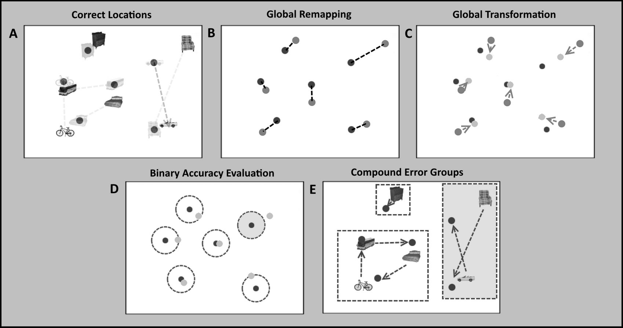
Reconstruction Errors Better Than Just Misplacement
Introduction
Reconstructing Relational Information
Spatiotemporal Reconstruction
Spatiotemporal Navigation
Conclusion
Errors are used to infer successful or unsuccessful memory for relations
To evaluate errors we:
Remove the identities of items and find a minimal association (i.e. a remapping of item-to-location which “forgives” errors due to identity misbinding)
Find shared error across items (i.e. “forgive” translation, scaling, and rotation errors)
Evaluate placement accuracy in any location (i.e. if an item is close enough to any item’s target location)
Determine if any errors exist within a compound error group

Slide 19
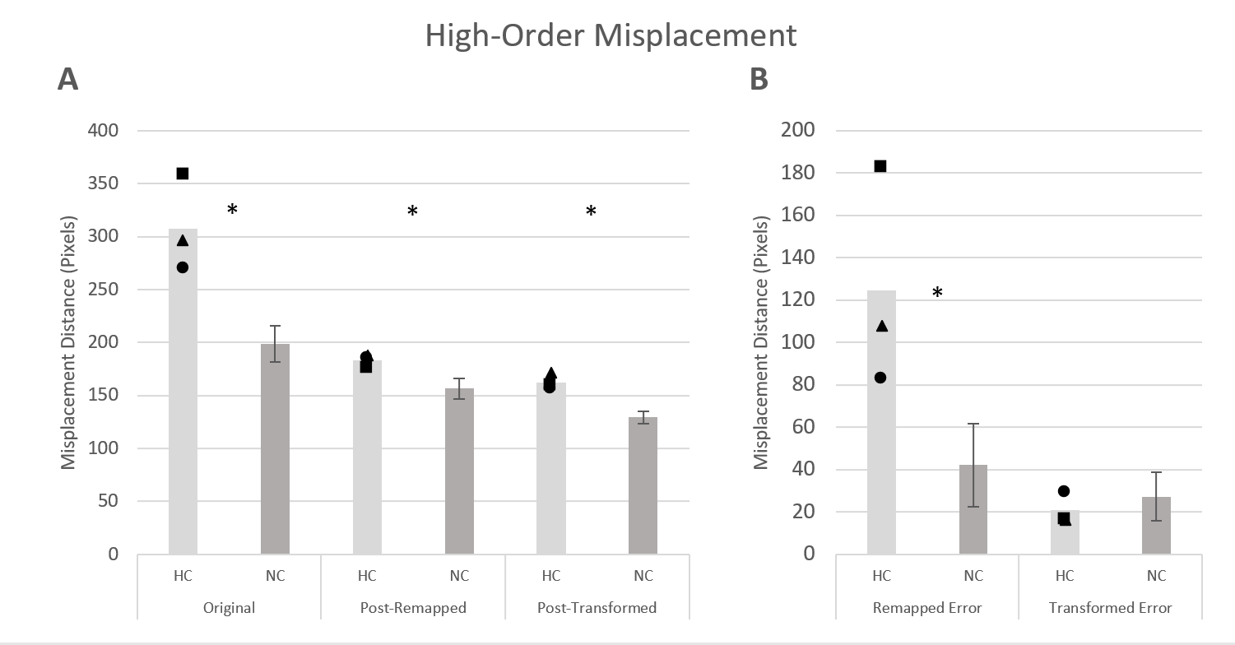
Hippocampal Damaged Patients Misplacement After Error Correction
Introduction
Reconstructing Relational Information
Spatiotemporal Reconstruction
Spatiotemporal Navigation
Conclusion
Patients have higher overall misplacement to begin with
Most of the misplacement (i.e. Euclidean distance of reconstructed points to targets) difference between patients and controls is due to identity-location binding
Total transformation error (translation, scaling, and rotation) does not differ between groups
These errors do not account for all group differences (i.e. some “local” error persists)
Subtraction of Left gives us the Right

Slide 20
Identity-Location Relational Errors
Introduction
Reconstructing Relational Information
Spatiotemporal Reconstruction
Spatiotemporal Navigation
Conclusion

Slide 21
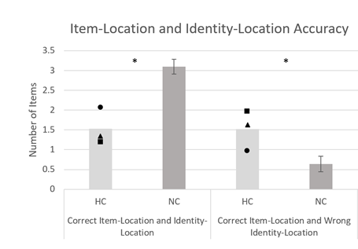
Hippocampal Damaged Patients (cont.) Misplacement After Error Correction
Introduction
Reconstructing Relational Information
Spatiotemporal Reconstruction
Spatiotemporal Navigation
Conclusion
Patients get fewer items correct overall
Identity-location errors (i.e. the number of items placed in another item’s location) occur more often in patients
No difference is found in memory for locations (i.e. the sum of the two bar graphs)
Note: Number of Items is the Average Number of Items Per Trial which fit the various criteria

Slide 22
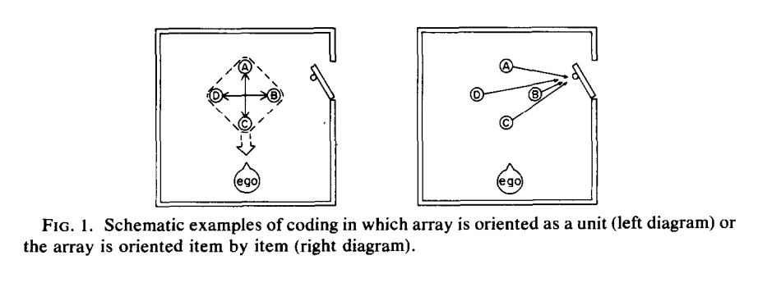
Huttenlocker & Presson 1979
Introduction
Reconstructing Relational Information
Spatiotemporal Reconstruction
Spatiotemporal Navigation
Conclusion
Reconstruction was used to answer a fairly narrow set of questions about egocentric coding of rotation transforms in children
Item-environment and Item-item relations were distinguished (though not named as such)
Manipulation involved changing description of the rotation (array rotated or viewer rotated)
With “appearance” questions (i.e. select from a set of drawings of the array), array-rotation was easier than viewer-rotation
With “item” questions (i.e. individual items were tested), viewer-rotation was easier than array-rotation

Slide 23
Global Item-Environment and Item-Item Relational Errors Transformations
Introduction
Reconstructing Relational Information
Spatiotemporal Reconstruction
Spatiotemporal Navigation
Conclusion

Slide 24
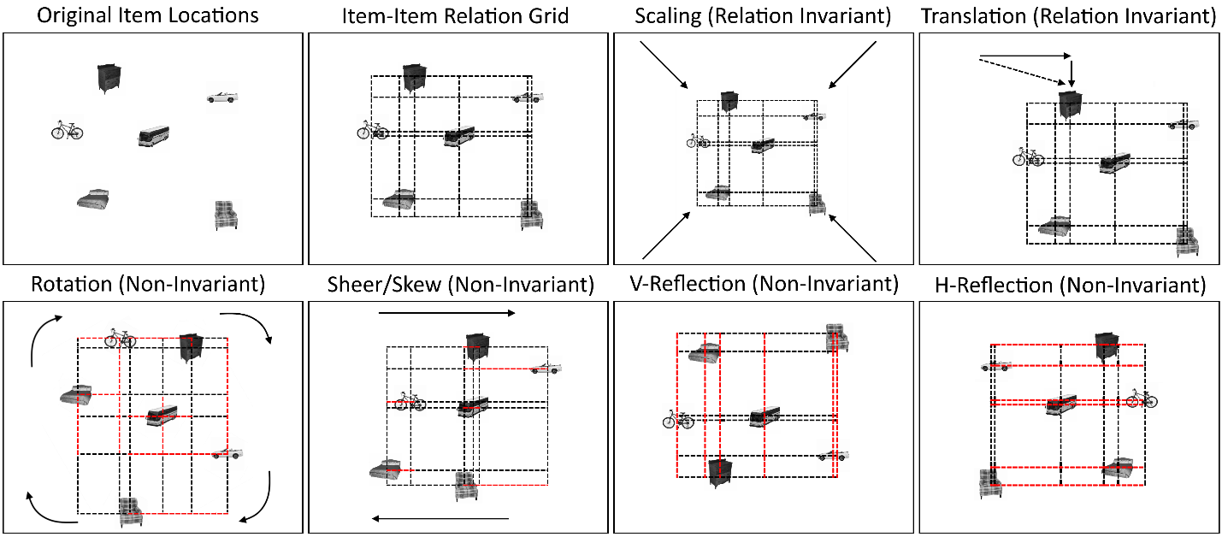
Invariance of Relational Information in Reconstruction under Transformations
Introduction
Reconstructing Relational Information
Spatiotemporal Reconstruction
Spatiotemporal Navigation
Conclusion
Mathematically, some transforms do not result in relational incongruity (i.e. are Relation Invariant)
Others are Non-invariant in that many relations can be corrupted
This relationship is bidirectional (i.e. relational errors can appear as transforms and vice versa)

Slide 25
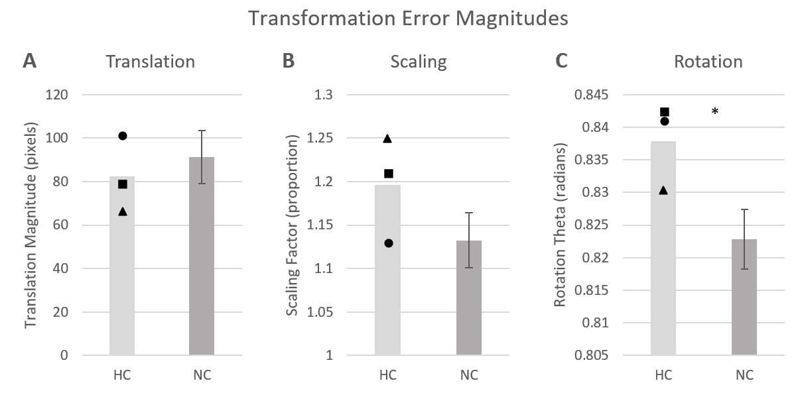
Transformation Metrics
Introduction
Reconstructing Relational Information
Spatiotemporal Reconstruction
Spatiotemporal Navigation
Conclusion
Hippocampal patients in this data do not show an overall transformation difference
When transform types are viewed individually, a deficit can be seen in Rotation (i.e. the singular Non-invariant transform in this analysis)

Slide 26
Compound Identity-location Relational Errors Swaps and Cycles
Introduction
Reconstructing Relational Information
Spatiotemporal Reconstruction
Spatiotemporal Navigation
Conclusion

Slide 27
Compound Relational Errors Reanalysis with Watson et al. 2013
Introduction
Reconstructing Relational Information
Spatiotemporal Reconstruction
Spatiotemporal Navigation
Conclusion
All compound errors can be compared to the Watson et al. 2013 metrics
Patients still uniquely commit errors at low set sizes
Once controls begin making identity-location errors, no difference is present in the number of accurate compound errors (True Swaps and Cycle Swaps)
Notes:
Note: This is all with the Watson et al. 2013 data. The pattern on 5-item trials holds in my data with 6 items (i.e. no significant difference between compound errors).

Slide 28
Compound Relational Errors Cycles and Swaps
Introduction
Reconstructing Relational Information
Spatiotemporal Reconstruction
Spatiotemporal Navigation
Conclusion
No significant differences is present between cycles and swaps if all items in the group are required to have accurate location information
For “partial” cycles and swaps, there are differences, but no strong inference about compound errors can be made from this
Notes:
This comparison is from my data set.

Slide 29
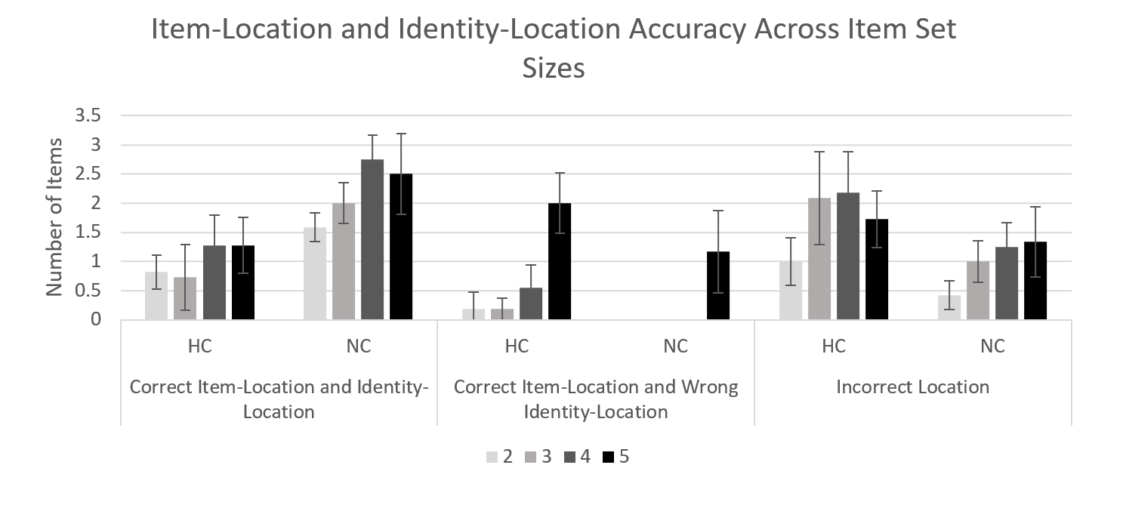
Identity-Location Errors Across Set Size Reanalysis of Data from Watson et al. 2013
Introduction
Reconstructing Relational Information
Spatiotemporal Reconstruction
Spatiotemporal Navigation
Conclusion
When the number of items is varied, hippocampal damaged patients uniquely commit identity-location binding errors even with only 2 items
Controls begin to commit these errors at 5 items
The critical error, regardless of set size, is identity-location errors
Note: Number of Items is the Average Number of Items Per Trial which fit the various criteria
Notes:
Note: In order to commit swaps/cycles, you must have committed a certain number of identity-location errors. Patients do not do that often at low set sizes (though they still commit swaps and cycles by chance). Even at set size 5, neither patients or controls commit enough to expect substantial number of compound errors.

Slide 30
What is “Chance Level” for compound errors?
Introduction
Reconstructing Relational Information
Spatiotemporal Reconstruction
Spatiotemporal Navigation
Conclusion
Cycle Size | Probability
Swap (2-Cycle) | 1/2
3-Cycle | 1/3
4-Cycle | 1/4
5-Cycle | 1/5
6-Cycle | 1/6
7-Cycle | 1/7
Ignore Space
Naïve 2D
Note: Accuracy Ratio Converges to 0.75
Naïve 2D Target Location Constraint
Distance Constraints
Data Driven

Slide 31
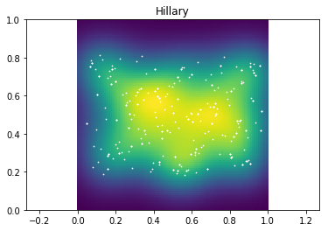
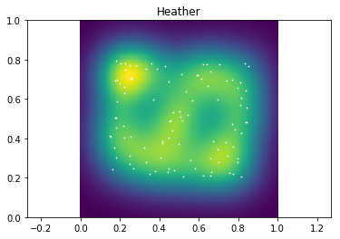
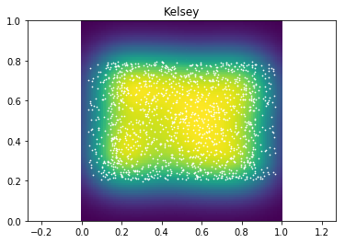
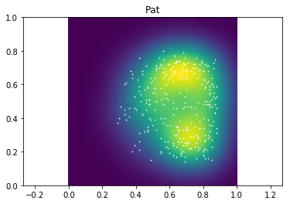
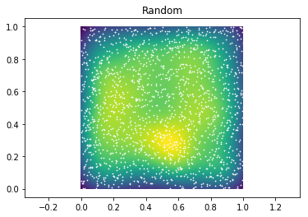
How We Choose Target Locations
Introduction
Reconstructing Relational Information
Spatiotemporal Reconstruction
Spatiotemporal Navigation
Conclusion
Random with Edge Constraint
Random with Distance Constraint
Random with Aspect Ratio Constraint
Table-Top (non-random)

Slide 32
“Chance Levels” with Target Location Constraint
Introduction
Reconstructing Relational Information
Spatiotemporal Reconstruction
Spatiotemporal Navigation
Conclusion
Despite the differences in target locations, if the participant acts randomly, the number of True Swaps only varies by about +-0.02 True Swaps per Trial
The direction of the variation is not reliable across numbers of items
Even in extreme cases, the biases do not create a severe systematic impact on chance levels (though they may impact participant behavior)

Slide 33
MRE and DTI Measures
Introduction
Reconstructing Relational Information
Spatiotemporal Reconstruction
Spatiotemporal Navigation
Conclusion
In the previous analysis, only the MRE measure correlated with any spatial reconstruction metrics (this relationship holds in the new metrics)
With the additional resolution of the new metrics, we see relationships with far more fidelity; in particular, we see that:
Increased hippocampal volume is associated with improved accurate single-item placement
Increased diffusivity (RD, AD, and MD) is related to increases in relational memory errors
Some of these relationships are sensitive to how we determine “accuracy” (trial-by-trial or collapsed)
Notes:
HC Volume relating positively to accurate single-item placement (i.e. proper binding of item to location) on a trial-by-trial basis is not surprising as increased hippocampal volume should mean increased success in binding item-location pairs.
RD (diffusion perpendicular to axonal fibers) could be related to myelination integrity due to axonal injury, predicting poorer performance with more radial diffusivity. Thus the interpretation here is that more radial diffusivity leads to poorer performance across trials in accurate placement. TL;DR Low RD good; High RD bad.
AD (diffusion parallel to axonal fibers) could be related to axonal injury as well, with reduction in AD in cases of pathology. Higher AD in this case can be interpreted as being detrimental in relational memory as seen in an increase in True Swaps as defined by out measure. TL;DR Low AD good; High AD bad.
MD (average of all diffusion eigenvalues) is an inverse measure of membrane density (higher MD means lower membrane density), thus the interpretation here is that higher mean diffusivity is related to more relational memory errors. TL;DR Low MD good; High MD bad.
In all of these cases, the take-away is that more diffusivity is bad for relational memory accuracy.
Note: FA is the one that goes in the opposite direction and is not strongly associated with any of the spatial measures.
http://www.diffusion-imaging.com/2013/01/relation-between-neural-microstructure.html

Slide 34
SMI Transformations
Introduction
Reconstructing Relational Information
Spatiotemporal Reconstruction
Spatiotemporal Navigation
Conclusion
In older adults, rotation, scaling and translation errors correlate with age, education and Subjective Memory Impairment
Rotation correlates positively with age and negatively with education
Scaling and translation both negatively correlate with SMI (where higher SMI scores indicate less subjective memory impairment)
Increases in different types of systematic misplacement may be related to different functions in an aging brain

Slide 35
Depression and True Swaps
Introduction
Reconstructing Relational Information
Spatiotemporal Reconstruction
Spatiotemporal Navigation
Conclusion
True swaps relate positive with repression, such that those rating higher in depression commit more true swaps
This relationship might prove stronger with more variance across the depression axis (this sample had mostly low-depression score individuals)
This relationship is specific to true swaps and not present in any of the other spatial reconstruction metrics

Slide 36
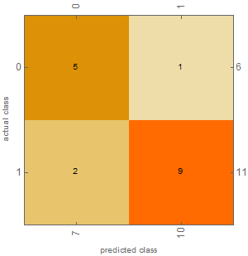
Special Mention: Epilepsy and Reconstruction Errors
Introduction
Reconstructing Relational Information
Spatiotemporal Reconstruction
Spatiotemporal Navigation
Conclusion
Although the sample size was small, a Logistic Regression classifier was able to train successfully to classify epilepsy via the spatial reconstruction measures
In a sample size of 17, the classifier attained 82% accuracy
This may prove to be an interesting direction with larger data sets
Notes:
Note: A similar attempt was made in MS data which was unable to train successfully

Slide 37
How We Treat Categorical Data
Introduction
Reconstructing Relational Information
Spatiotemporal Reconstruction
Spatiotemporal Navigation
Conclusion
Categorical data can be described by assigning a class label to each point
We can then ask if relational memory errors are more common within categorical groups than across
This question is tricky as there are more opportunities to perform across category identity-location errors than within (and this difference is dependent upon the number of items)

Slide 38
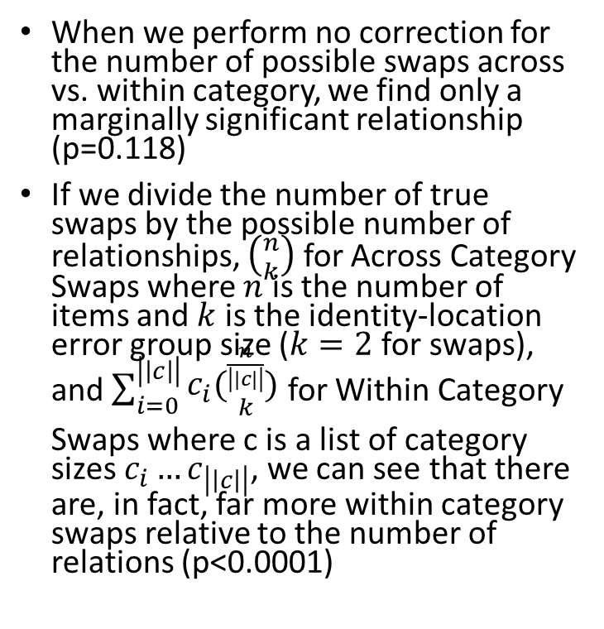
Within and Across Category Swaps
Introduction
Reconstructing Relational Information
Spatiotemporal Reconstruction
Spatiotemporal Navigation
Conclusion
When we perform no correction for the number of possible swaps across vs. within category, we find only a marginally significant relationship (p=0.118)
If we divide the number of true swaps by the possible number of relationships, $\left({n \atop k}\right)$ for Across Category Swaps where $n$ is the number of items and $k$ is the identity-location error group size ($k=2$ for swaps), and $\sum_{i=0}^{\left|\left|c\right|\right|}{\begin{aligned}c_{i}({\frac{n}{\left|\left|c\right|\right|} \atop k}) \\ \end{aligned}}$ for Within Category Swaps where c is a list of category sizes $c_{i}…c_{\left|\left|c\right|\right|}$, we can see that there are, in fact, far more within category swaps relative to the number of relations (p<0.0001)

Slide 39
Take-Aways
Introduction
Reconstructing Relational Information
Spatiotemporal Reconstruction
Spatiotemporal Navigation
Conclusion
The hippocampus is critical binding of arbitrary information (identity-location binding)
Some relational information can be reconstructed by hippocampal damaged patients (location information without identities – though precision may be impaired)
Compound errors are not more common with hippocampal damage
Healthy individuals also commit relational errors once the task becomes sufficiently demanding

Slide 40
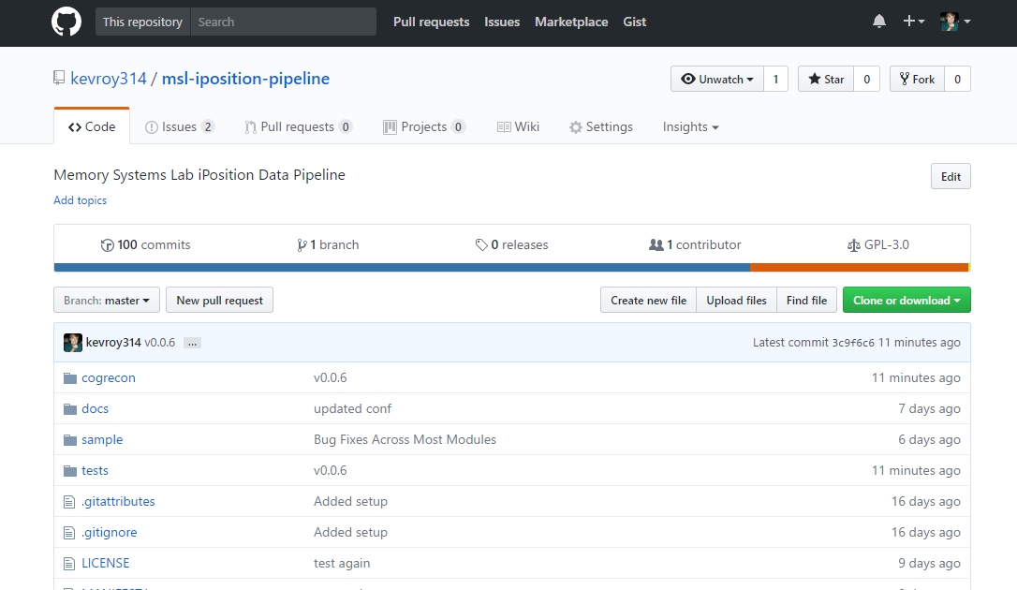
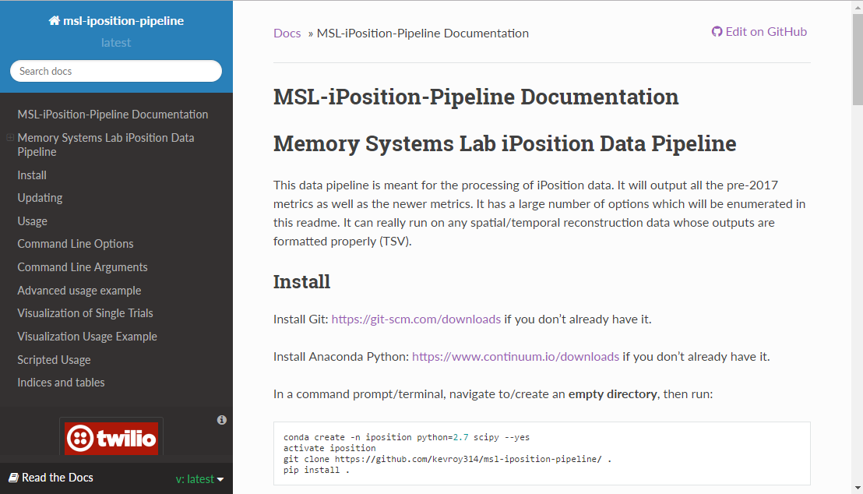
MSL iPosition Pipeline
Introduction
Reconstructing Relational Information
Spatiotemporal Reconstruction
Spatiotemporal Navigation
Conclusion
The analysis code is all open source on GitHub.

Slide 41
Memory During Time Travel
Introduction
Reconstructing Relational Information
Spatiotemporal Reconstruction
Spatiotemporal Navigation
Conclusion
Spatiotemporal Navigation, Contextual Boundaries, and Relational Memory Errors in Virtual Reality
Study 2 (Manuscript Prepared)
Context
Episodes
Space
Time
Notes:
Although time travel has been a staple of science fiction for decades, the concept hasn’t gained much traction in science fact.

Slide 42
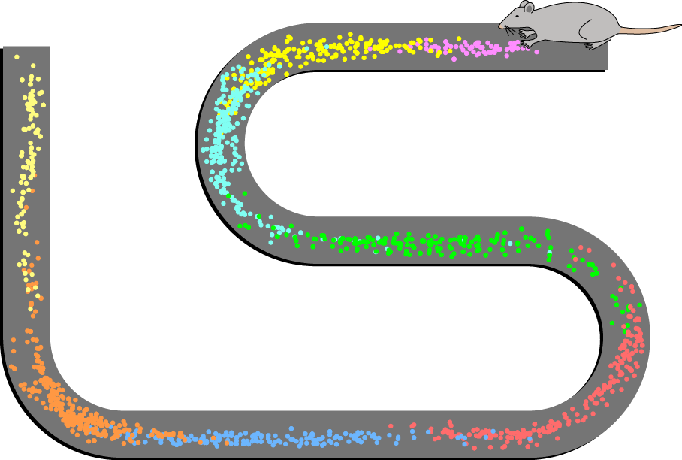
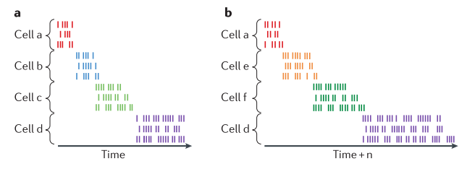
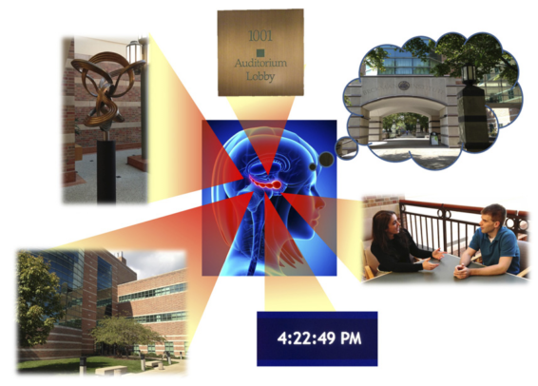
Episodic Memory
Introduction
Reconstructing Relational Information
Spatiotemporal Reconstruction
Spatiotemporal Navigation
Conclusion
Place cells fire in association with specific, allocentrically defined locations in space during navigation
Place cells can remap in accordance with translation and scaling transformations but not changes in shape
“Time” cells fire in relation to moments in time relative to the start of a trial
Time cells scale with scaling of temporal distances (see a vs. b on the bottom right)
Episodic memory can be defined as memory for specific/precise events in space and time, framed by context
Context can be defined as additional, often more stable/protracted, information which is indirectly related to an episode
Episodic memory critically relies on the hippocampus

Slide 43
Hippocampal Cell Populations (place cells)
Introduction
Reconstructing Relational Information
Spatiotemporal Reconstruction
Spatiotemporal Navigation
Conclusion
Place cells fire in association with specific locations in space during navigation
These locations are allocentrically defined
Place cells can remap in accordance with translation and scaling transformations
Place cells do not successfully remap with changes in shape information

Slide 44
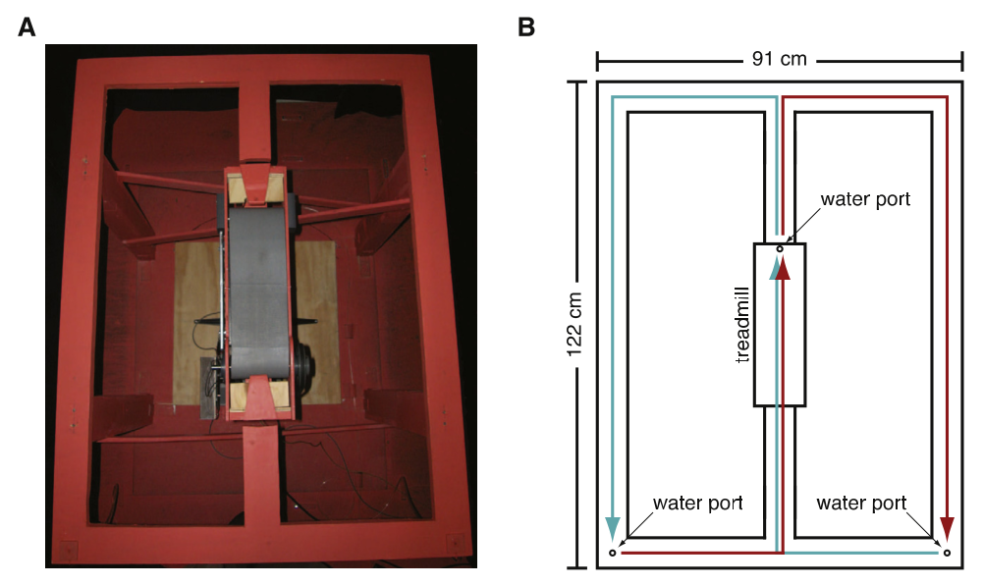
Hippocampal Cell Populations (time cells)
Introduction
Reconstructing Relational Information
Spatiotemporal Reconstruction
Spatiotemporal Navigation
Conclusion
Similarly to place cells, some cells in the hippocampus known as “time” cells fire in relation to moments in time relative to the start of a trial
A figure 8 maze with a variable speed treadmill can be used to disentangle time from distance
Time cells scale with scaling of temporal distances (see a vs. b on the bottom right)

Slide 45
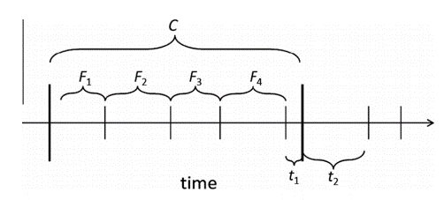
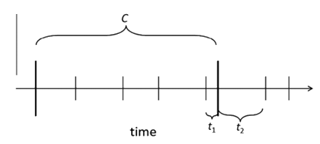
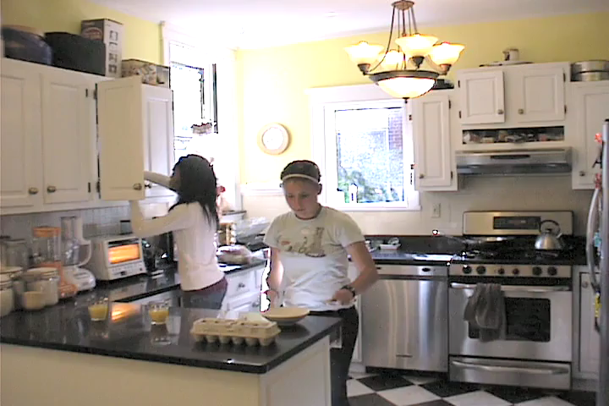
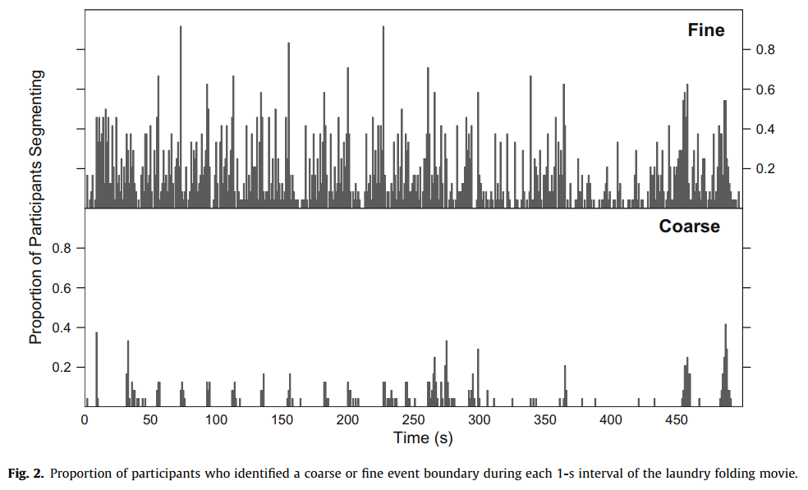
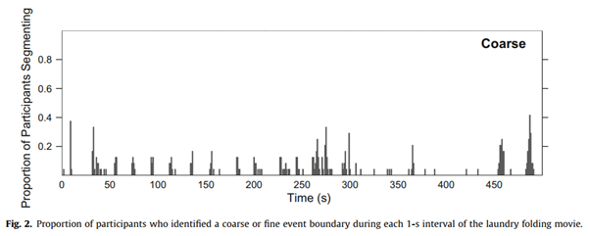
Zacks et al. 2007
Introduction
Reconstructing Relational Information
Spatiotemporal Reconstruction
Spatiotemporal Navigation
Conclusion
Event modeling: what constitutes an “event” and how events are segmented?
Zacks et al. has shown that individuals naturally segment continuous streams of information into event segments of different resolutions
Coarsely, event boundaries divide up continuous time to aid in describing and organizing memory for those events

Slide 46
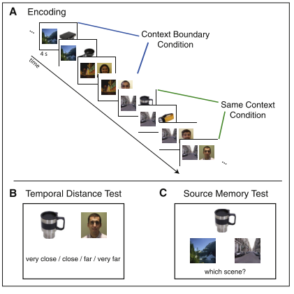
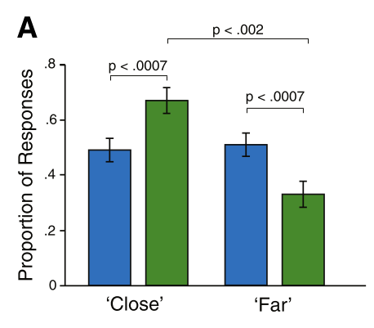
Davachi et al. 2013
Introduction
Reconstructing Relational Information
Spatiotemporal Reconstruction
Spatiotemporal Navigation
Conclusion
Discrete distance judgements and source memory were evaluated
For “Close” and “Far” judgements, a context boundary effect can be seen such that objects separated by a boundary are more likely to be judged as “Far”
This effect has also been related to the hippocampus

Slide 47

Davachi et al. 2013 (cont.)
Introduction
Reconstructing Relational Information
Spatiotemporal Reconstruction
Spatiotemporal Navigation
Conclusion
Pattern similarity for “Close” items was higher than “Far” in left hippocampus
This difference was specifically present in the Context Boundary condition
This suggests the hippocampus plays a special role in binding information across contextual boundaries

Slide 48
Three Worlds Collide
Introduction
Reconstructing Relational Information
Spatiotemporal Reconstruction
Spatiotemporal Navigation
Conclusion
Spatial Reconstruction, Navigation, and Context Boundaries

Slide 49



Spatial Reconstruction in VR
Introduction
Reconstructing Relational Information
Spatiotemporal Reconstruction
Spatiotemporal Navigation
Conclusion
Doors
4 Items/Room
Trial 1
Items Invisible Until Within Distance of 25% Room Size
4 Context Rooms
8 Random Start Locations
Trial 4

Slide 50
Context Boundary Effects
Introduction
Reconstructing Relational Information
Spatiotemporal Reconstruction
Spatiotemporal Navigation
Conclusion
Context boundary effects, where within-context items are placed closer together and across-context items farther apart, are seen
Context-crossing items account for the majority of the effect
The effect is relatively stable across trials, remaining consistent past Trial 2 even as accuracy continues to improve

Slide 51
Tulving’s Time Travel
Introduction
Reconstructing Relational Information
Spatiotemporal Reconstruction
Spatiotemporal Navigation
Conclusion
“Time’s arrow is straight… the singular exception is provided by the human ability to remember past happenings… The rememberer has mentally traveled back into her past…” – Tulving, 2002

Slide 52


Spatiotemporal Reconstruction in VR
Introduction
Reconstructing Relational Information
Spatiotemporal Reconstruction
Spatiotemporal Navigation
Conclusion

Slide 53

Spatiotemporal Reconstruction in VR (cont.)
Introduction
Reconstructing Relational Information
Spatiotemporal Reconstruction
Spatiotemporal Navigation
Conclusion
43 young adult participants (ages 18-24; 23 male)
Virtual Reality using the Oculus Rift
Study events in space and time
4 study/test trials with the same set of events in the same environment

Slide 54
Overall Performance
Introduction
Reconstructing Relational Information
Spatiotemporal Reconstruction
Spatiotemporal Navigation
Conclusion
Overall performance improved across trials on simple study and test metrics (errors space and time)
Error in space seemed to hit floor by trial 3 while time continued to improve

Slide 55
Event Errors
Introduction
Reconstructing Relational Information
Spatiotemporal Reconstruction
Spatiotemporal Navigation
Conclusion
Event errors also improve across trials, with no significant difference between trials 3 and 4
Even at trial 4, 3/10 events are erroneously labelled

Slide 56


Identity-location Errors in Space vs. Time
Introduction
Reconstructing Relational Information
Spatiotemporal Reconstruction
Spatiotemporal Navigation
Conclusion
Analyze space and time independently
Use relational memory metrics (identity-location errors)
There are far more relational memory errors in space than in time in this task
Space (m)
Time (s)
Note: Number of Identities is the Average Number of Identities Per Trial which fit the various criteria

Slide 57
Spatial Context Boundary Effects with Temporal Contexts
Introduction
Reconstructing Relational Information
Spatiotemporal Reconstruction
Spatiotemporal Navigation
Conclusion
With temporal context boundary effects, we only evaluate the effect when the participant placed the item in the correct context
With spatial context boundary effects and temporal contexts, we are free to include or exclude temporally accurate items
When we exclude them, as we did with the temporal contexts, we see a nonsignificant relationship (p~0.16) with the same direction as the typical context boundary effect
When we include the contextually incorrect items, we see a significant but inverse effect as the typical context boundary effect (p~0.001)

Slide 58
Context and Relational Memory
Introduction
Reconstructing Relational Information
Spatiotemporal Reconstruction
Spatiotemporal Navigation
Conclusion
Identity-location errors (temporal item misbindings) would be expected by chance to occur within context around 14% of the time
They occur >40% of the time, and the error gets worse across trials
This is true even when looking at the raw Identity-location errors
Notes:
When we observe relational memory errors as they relate to contexts, we also find that these more discrete errors in binding are also biased by context such that a roughly equal number of swaps occur within the same contexts as across, despite the number of opportunities to swap across context being substantially greater. Thus, contexts can once again be seen to provide high-level structure to remembered events in space-time.

Slide 59
Temporal Context Boundary Effects
Introduction
Reconstructing Relational Information
Spatiotemporal Reconstruction
Spatiotemporal Navigation
Conclusion
Context Boundary Effects are scaling transformations
They reflect a systematic bias due to context on distance judgements
This bias is not diminished by restudy or freely crossing boundaries
Notes:
In addition to evaluating event reconstruction errors, we can observe the effect contextual changes have on reconstruction. Here we can see a Context Boundary effect in which items sharing temporal context are placed closer together in time than their original distance and items across context are placed farther apart. This effect is stable across multiple study/test trials of the same items and thus is thought to represent a structural bias in the remembered locations due to contextual information.

Slide 60
Take-Aways
Introduction
Reconstructing Relational Information
Spatiotemporal Reconstruction
Spatiotemporal Navigation
Conclusion
Relational memory errors are far more common in temporal location information than spatial in this task
Context boundaries influence relational memory/order memory performance such that within context relational errors occur more often with restudy
Context boundary effects are persistent even with restudy and the ability to freely cross context boundaries

Slide 61
Spatiotemporal Navigation, Sampling, and Information In-The-Moment in Virtual Reality
Spatiotemporal Reconstruction
Introduction
Spatiotemporal Reconstruction
Introduction
Reconstructing Relational Information
Reconstructing Relational Information
Spatiotemporal Navigation
Spatiotemporal Navigation
Conclusion
Conclusion
Path and Order Analyses
Study 3 (Proposed)
Context
Episodes
Space
Time
Sampling

Slide 62

Spatial Distance and Temporal Distance
Introduction
Reconstructing Relational Information
Spatiotemporal Reconstruction
Spatiotemporal Navigation
Conclusion
Space and time can be explored independently, so spatial and temporal distance travelled can be measured in isolation of one another
Both distance metrics use Euclidean, L2 distance
Note: Spatial distance can be travelled without moving in time & temporal distance can be travelled without moving in space
Temporal Distance
Spatial Distance

Slide 63



Study Exploration vs. Test Metrics
Introduction
Reconstructing Relational Information
Spatiotemporal Reconstruction
Spatiotemporal Navigation
Conclusion
Study
Test
Trial 1
These metrics improve across trials
The relationship between these metrics and test time results will also be explored
Trial 4

Slide 64





Fractal Dimension (FD)
Introduction
Reconstructing Relational Information
Spatiotemporal Reconstruction
Spatiotemporal Navigation
Conclusion
Used previously in Virtual Morris Water Maze
FD is a measure of the complexity of a path, rather than its explicit distance in space
Changes in FD across spatial navigation trials have been associated with hippocampal volume
Changes in FD as well as distance learning slope have been related to subiculum volume
Example Path
Linear Fit
Slope of Fit (aka FD)

Slide 65




Kernel Density Estimation of Spatiotemporal Exploration
Introduction
Reconstructing Relational Information
Spatiotemporal Reconstruction
Spatiotemporal Navigation
Conclusion
Trial 1
Trial 2
Regardless of trial number, the standard pattern of attending to items persists (as this is a task requirement), but the variability and item-confusion decreases across trials
The paths in trial 1 are highly variable as no item locations are known, but the variability quickly drops by trial 2
Note that the items which are being erroneously explored are often the temporal-contextually associated item
Trial 3
Trial 4
Trial-over-trial paths also show interesting patterns such as wall-following
Notes:
Finally, current work involves mapping patterns of exploration using advanced machine learning techniques in order to understand if these biases result in systematic changes in exploration as well. Here we can see a visualization of the exploration locations of all participants at given moments in time. Notice that for each hot spot which appears, there is often a secondary hot spot which appears simultaneously. These are often reflective of the participants systematically visiting the incorrect item which shares a context with the correct item, suggesting exploration, in addition to later remembering, is also systematically biased by context.

Slide 66
Planned Path Analyses
Introduction
Reconstructing Relational Information
Spatiotemporal Reconstruction
Spatiotemporal Navigation
Conclusion
Measure | Comparison | Support | Hypotheses
Spatial Distance | All Test Measures | (Maguire et al., 1999; Moffat, 2009; Moffat & Resnick, 2002) | None (exploratory)
Temporal Distance | All Test Measures | (Kraus et al., 2015a) | None (exploratory)
Fractal Dimension | Relational Memory Error | (Daugherty et al., 2015) | Higher FD will relate to poorer relational memory performance.
Context Boundary Crossings | Context Boundary Effect & Context-Relational Errors | (Ezzyat & Davachi, 2014; Zacks et al., 2007) | More context crossings will relate to greater context boundary effects and more context-relational errors.
Item Sampling | Item Misplacement | (Hannula et al., 2010) | In early trials, more sampling will relate to better memory. In later trials, less sampling will relate to better memory.

Slide 67
Order Information Metrics
Introduction
Reconstructing Relational Information
Spatiotemporal Reconstruction
Spatiotemporal Navigation
Conclusion
How should we treat order?
Order of study (i.e. clicking to acknowledge the events)
Order of test (i.e. placing the items in given locations)
Ideally, we want a hypothesized order and a test of how “close” participants are to that order; aka a distance metric for order
An illustration:
Which is closer to [1,2,3,4,5,6,7,8]:
[8,7,6,5,4,3,2,1],
[5,6,7,8,1,2,3,4], or
[2,1,4,3,6,5,8,7]?
Reflection
Rearrangement
Item-Wise

Slide 68



Kendall Tau Distance Item-Wise and Reflection
Introduction
Reconstructing Relational Information
Spatiotemporal Reconstruction
Spatiotemporal Navigation
Conclusion
Represents pairwise rearrangements (including reflections)
Positive 1.0 is forward ordering (i.e. 1,2,3,4,5,…)
Negative 1.0 is reverse ordering (i.e. 8,7,6,5,4,…)
0.0 is maximally far from either of those options
Note that across all possible permutations, 0.0 is the most common result and 1.0 or -1.0 are extremely improbable by chance
This method penalizes contiguity (i.e. 5,6,7,8,1,2,3,4)

Slide 69


Contiguity Distance Rearrangement
Introduction
Reconstructing Relational Information
Spatiotemporal Reconstruction
Spatiotemporal Navigation
Conclusion
Count the number of contiguous sublists
Example: [5,6,7,8,1,2,3,4] has two contiguous sublists [5,6,7,8] and [1,2,3,4]
Note that if the reverse direction were hypothesized, this could easily be performed in reverse (i.e. [4,3,2,1,8,7,6,5] has two contiguous sublists [4,3,2,1] and [8,7,6,5])
Together, Kendall Tau and Contiguous Distance make a 2D distance space

Slide 70


Trial-Over-Trial Flow
Introduction
Reconstructing Relational Information
Spatiotemporal Reconstruction
Spatiotemporal Navigation
Conclusion
We can visualize the space in 3D where vertical is the probability of each discrete distance combination
The point at (1.0, 0.0) corresponds to a hypothetical convergence towards “forward” exploration and reconstruction
We can construct a hypothetical probability distribution and observe what a trend like this should look like

Slide 71
Planned Path Analyses
Introduction
Reconstructing Relational Information
Spatiotemporal Reconstruction
Spatiotemporal Navigation
Conclusion
Measure | Comparison | Support | Hypotheses
Spatial Distance | All Test Measures | (Maguire et al., 1999; Moffat, 2009; Moffat & Resnick, 2002) | None (exploratory)
Temporal Distance | All Test Measures | (Kraus et al., 2015a) | None (exploratory)
Fractal Dimension | Relational Memory Error | (Daugherty et al., 2015) | Higher FD will relate to poorer relational memory performance.
Context Boundary Crossings | Context Boundary Effect & Context-Relational Errors | (Ezzyat & Davachi, 2014; Zacks et al., 2007) | More context crossings will relate to greater context boundary effects and more context-relational errors.
Item Sampling | Item Misplacement | (Hannula et al., 2010) | In early trials, more sampling will relate to better memory. In later trials, less sampling will relate to better memory.
Order Analyses | Order Over Trials Study vs. Test Order | Novel Metric | Order will converge to “allocentric,” map-like order (i.e. 1,2,3,4,5,6,7,8). Study and Test Order will be similar.

Slide 72
Hypotheses
Introduction
Reconstructing Relational Information
Spatiotemporal Reconstruction
Spatiotemporal Navigation
Conclusion
More exploration in space or time will relate to better memory performance in earlier trials and worse memory performance in later trials
Higher FD will relate to poorer relational memory performance
More context crossings will relate to greater context boundary effects and more context-relational errors
In early trials, more sampling will relate to better memory, but in later trials, less sampling will relate to better memory
Exploration order will converge to an “allocentric” order

Slide 73
Overall Conclusions
Introduction
Reconstructing Relational Information
Spatiotemporal Reconstruction
Spatiotemporal Navigation
Conclusion
Not all types of relations are impaired in hippocampal damage, but specifically arbitrary relations are impaired
Space and time may be represented separably in the hippocampus
Contextual shifts systematically bias both relational memory and distance judgements in time
Spatiotemporal navigation tasks can be used to study cognitive maps in the temporal domain in the service of in-the-moment, memory guided behavior
Context
Episodes
Space
Time
Sampling

